Slide 1
You couldn’t make it up !
Eric Watts

Slide 2
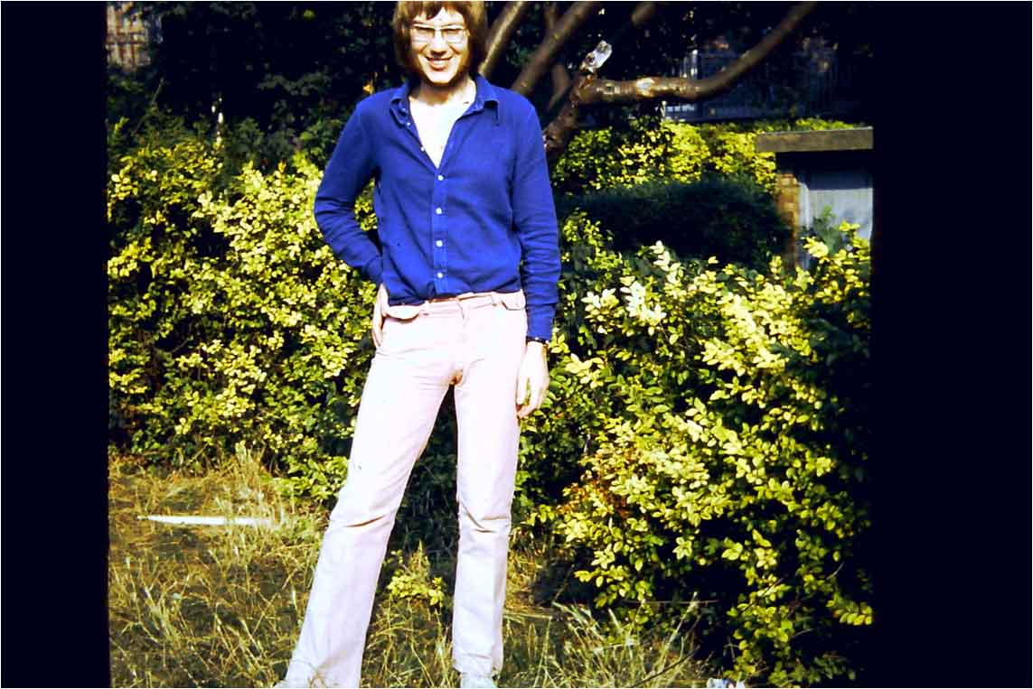

Slide 3

Norbert was getting doubts about Essex Airways

Slide 4
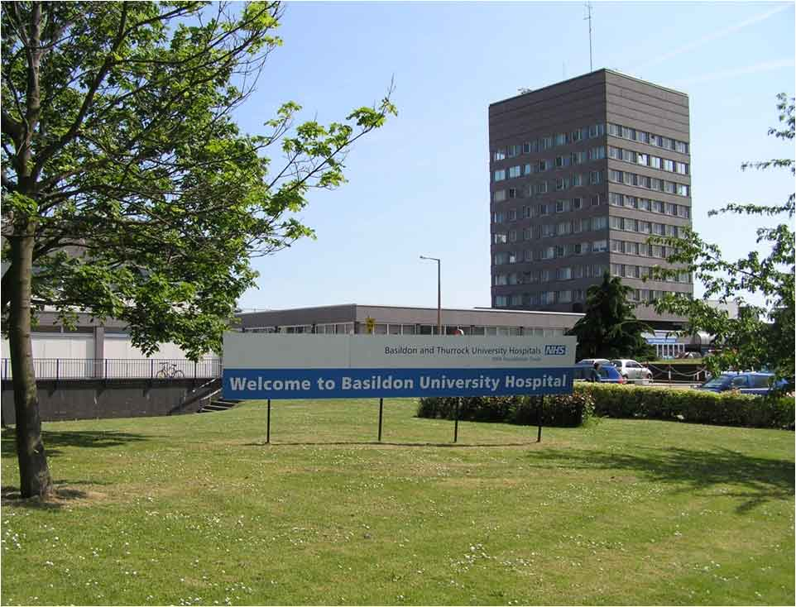

Slide 5
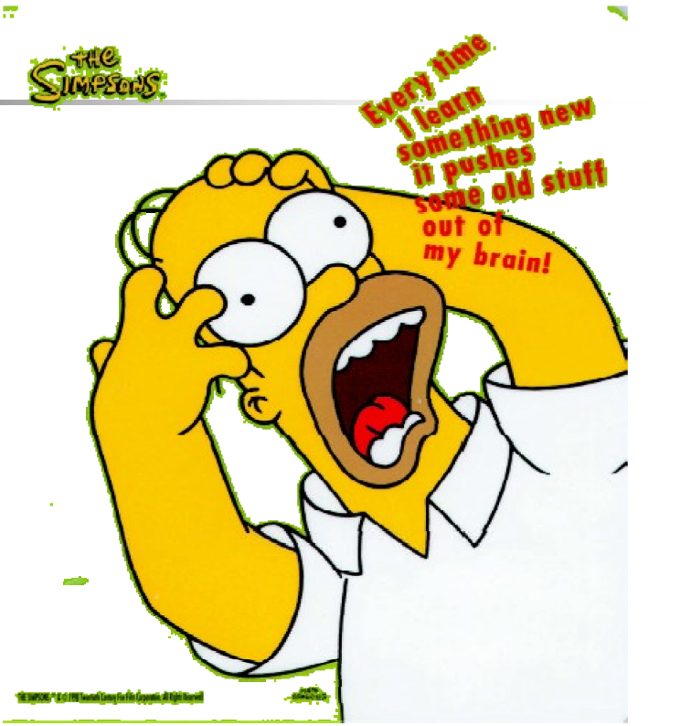

Slide 6
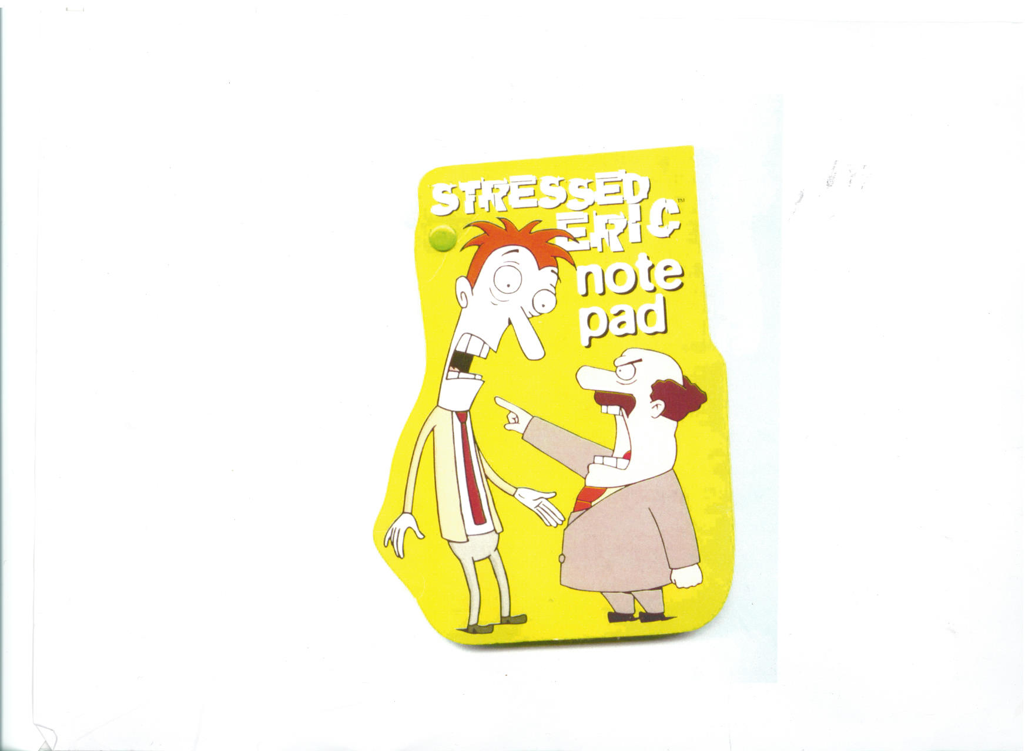

Slide 7
My First Year
3 colleagues in trouble
Radiologist dismissed
Oncologist suspended
Lab Technician in prison

Slide 8
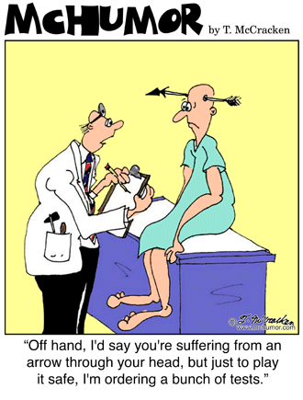
MEDICINE

Slide 9

Thromboprophylaxis & CQUIN
A view from the Sharp End
CQUIN – Commissioning for Quality and Innovation
Part of High Quality Care For All – Next Stage Review 2008
December 2009, two national targets set to be in place from April – one reducing VTE

Slide 10
ACRONYMS
Targetted
Evaluable
Structured
Costed
Open to scrutiny

Slide 11
ACRONYMS
T argetted
E valuable
S tructured
C osted
O pen to scrutiny

Slide 12
CQUIN ?
CRAFTY
QUESTIONABLE
UNHELPFUL
INCOMPREHENSIBLE
NIT PICKING

Slide 13
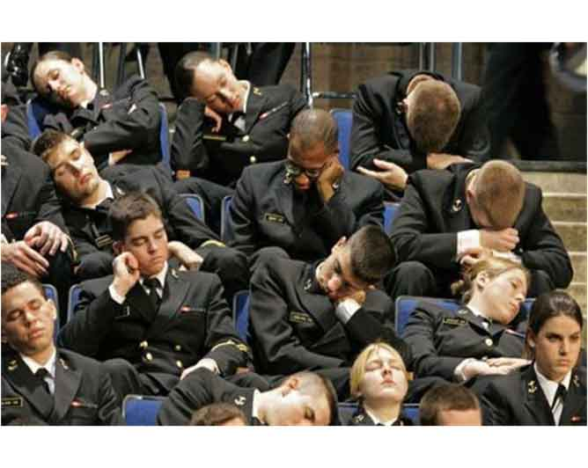
Communication Meetings

Slide 14
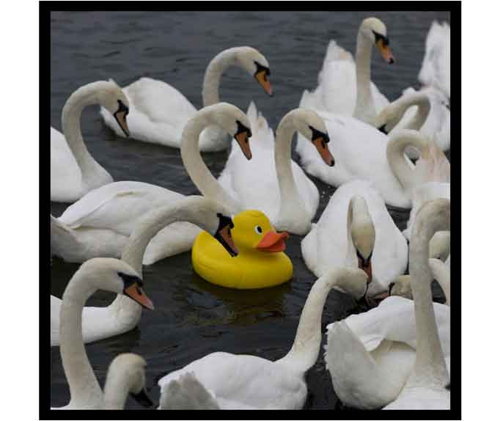
Guidelines to Identify Exceptional Cases

Slide 15
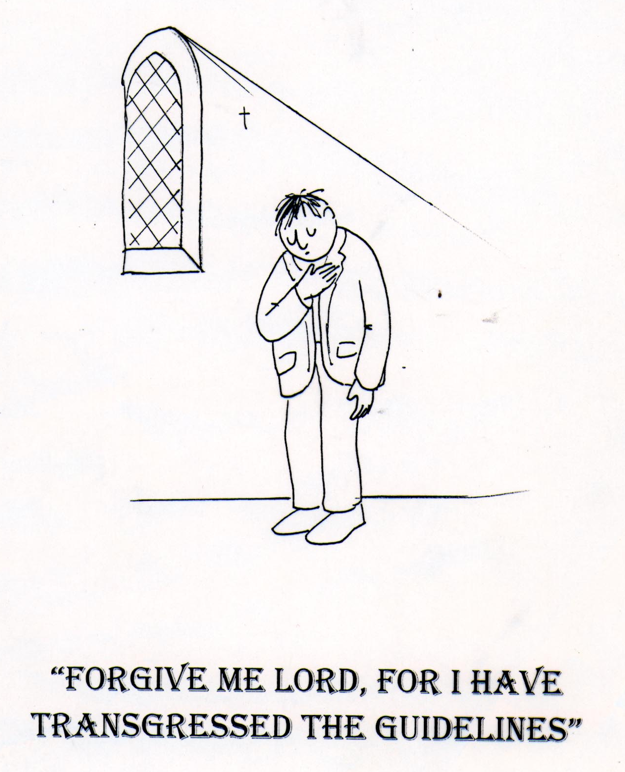
NICE Guidance Circulated

Slide 16
Failure to follow guidelines taken more seriously

Slide 18
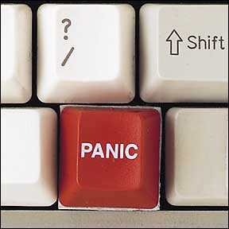
Response of the CDB

Slide 19
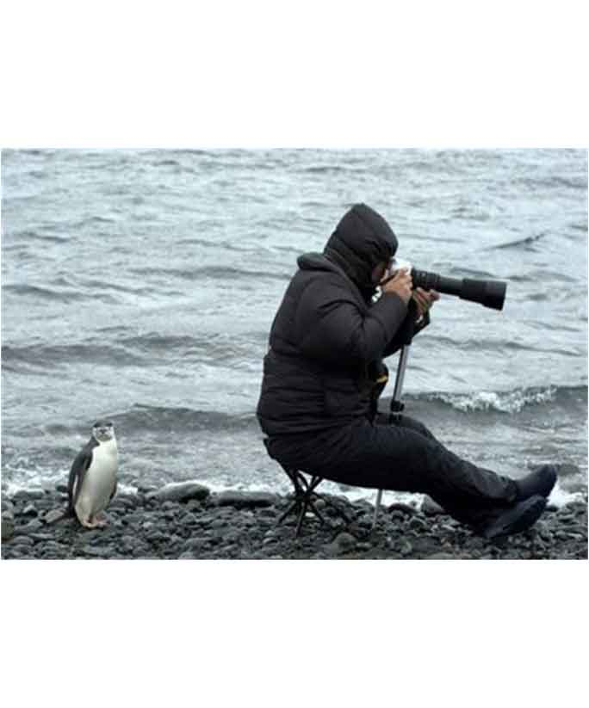
Are CQUIN Focussing on the Right Target ?
Do they have a track record ?

Slide 20

Are we on the same planet? Animal Design by CQUIN

Slide 21

Security surveillance by CQUIN.

Slide 22
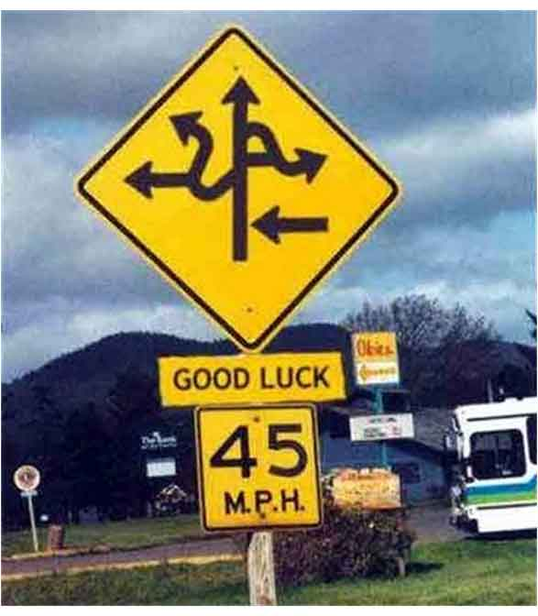
We followed the signposts by CQUIN

Slide 23
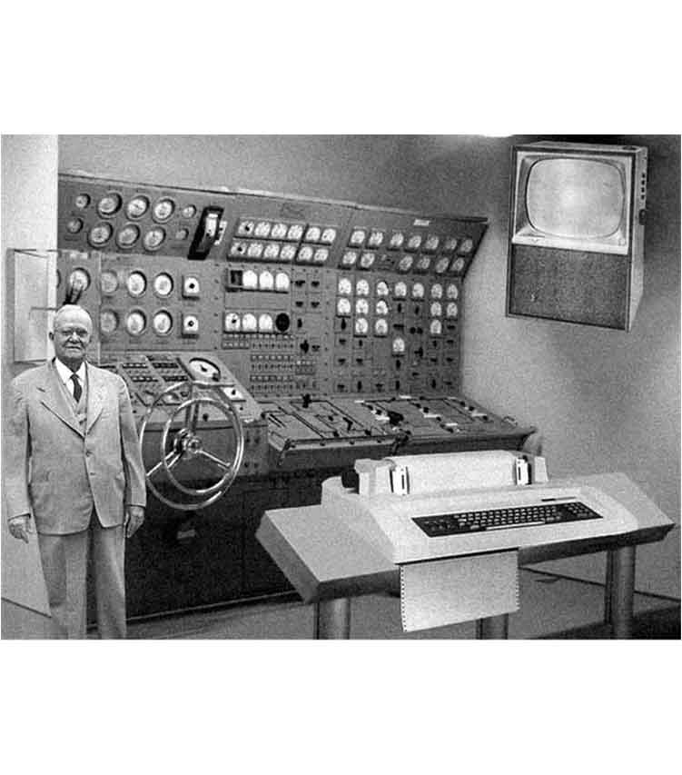
Review of IT Facilities

Slide 24
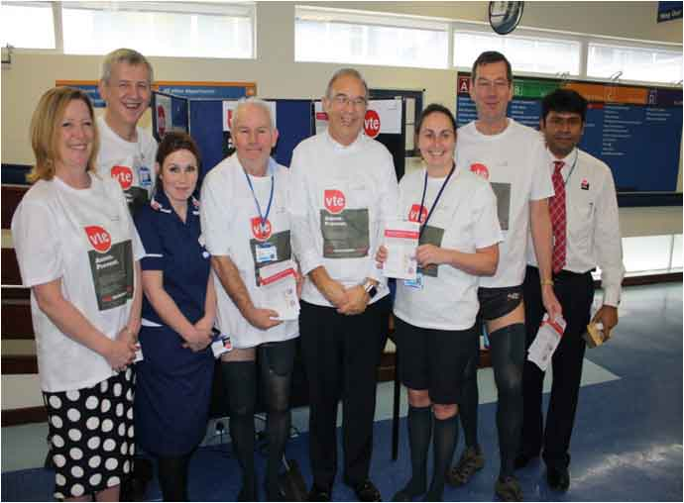
Raising awareness of thromboprophylaxis for staff, patients & public in the Hospital foyer

Slide 25


Slide 27
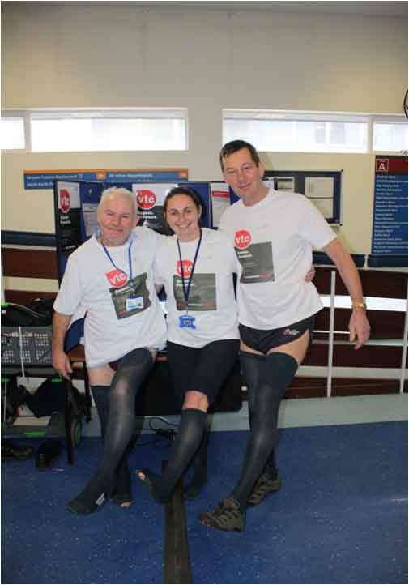

Slide 28
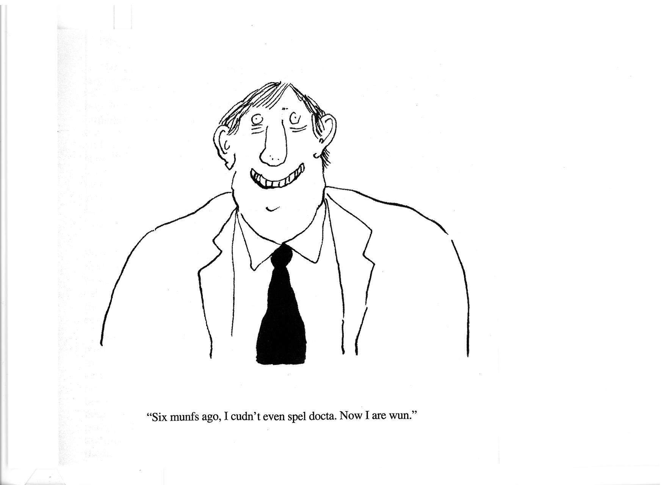

Slide 29
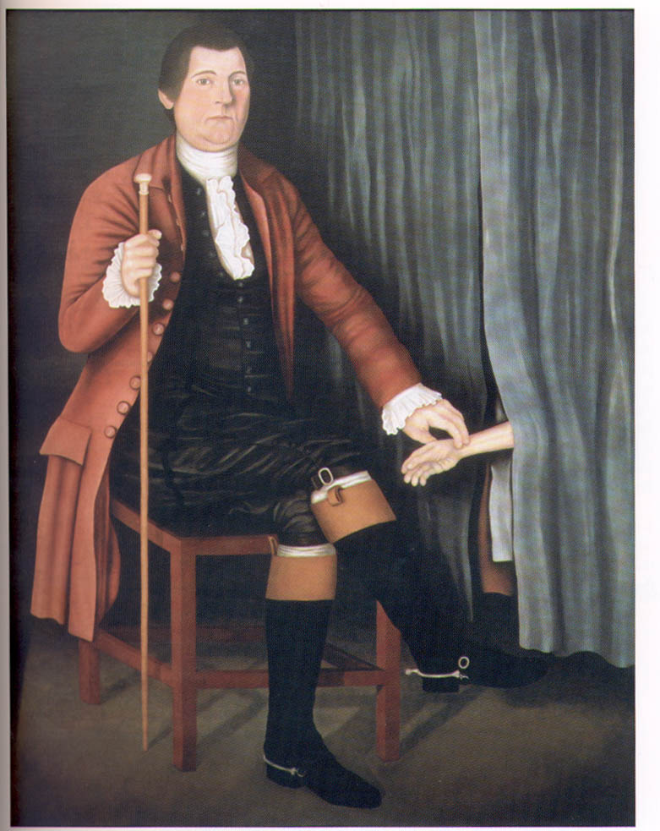
The shy physician

Slide 30
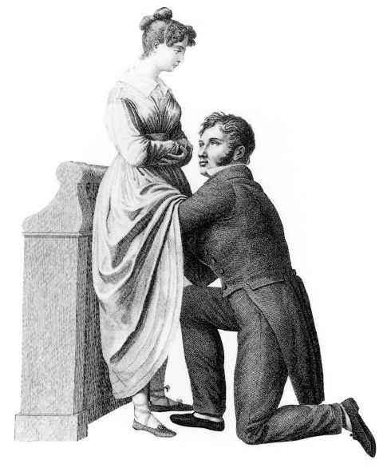

Slide 31
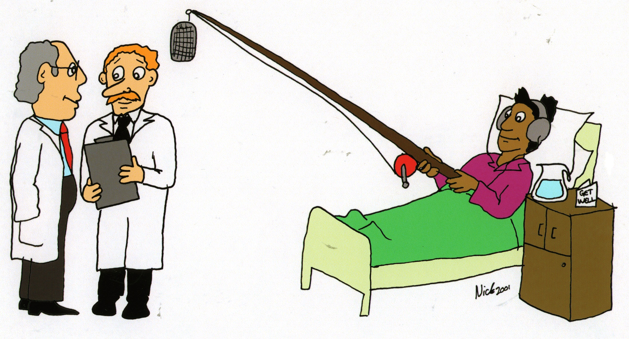

Slide 32
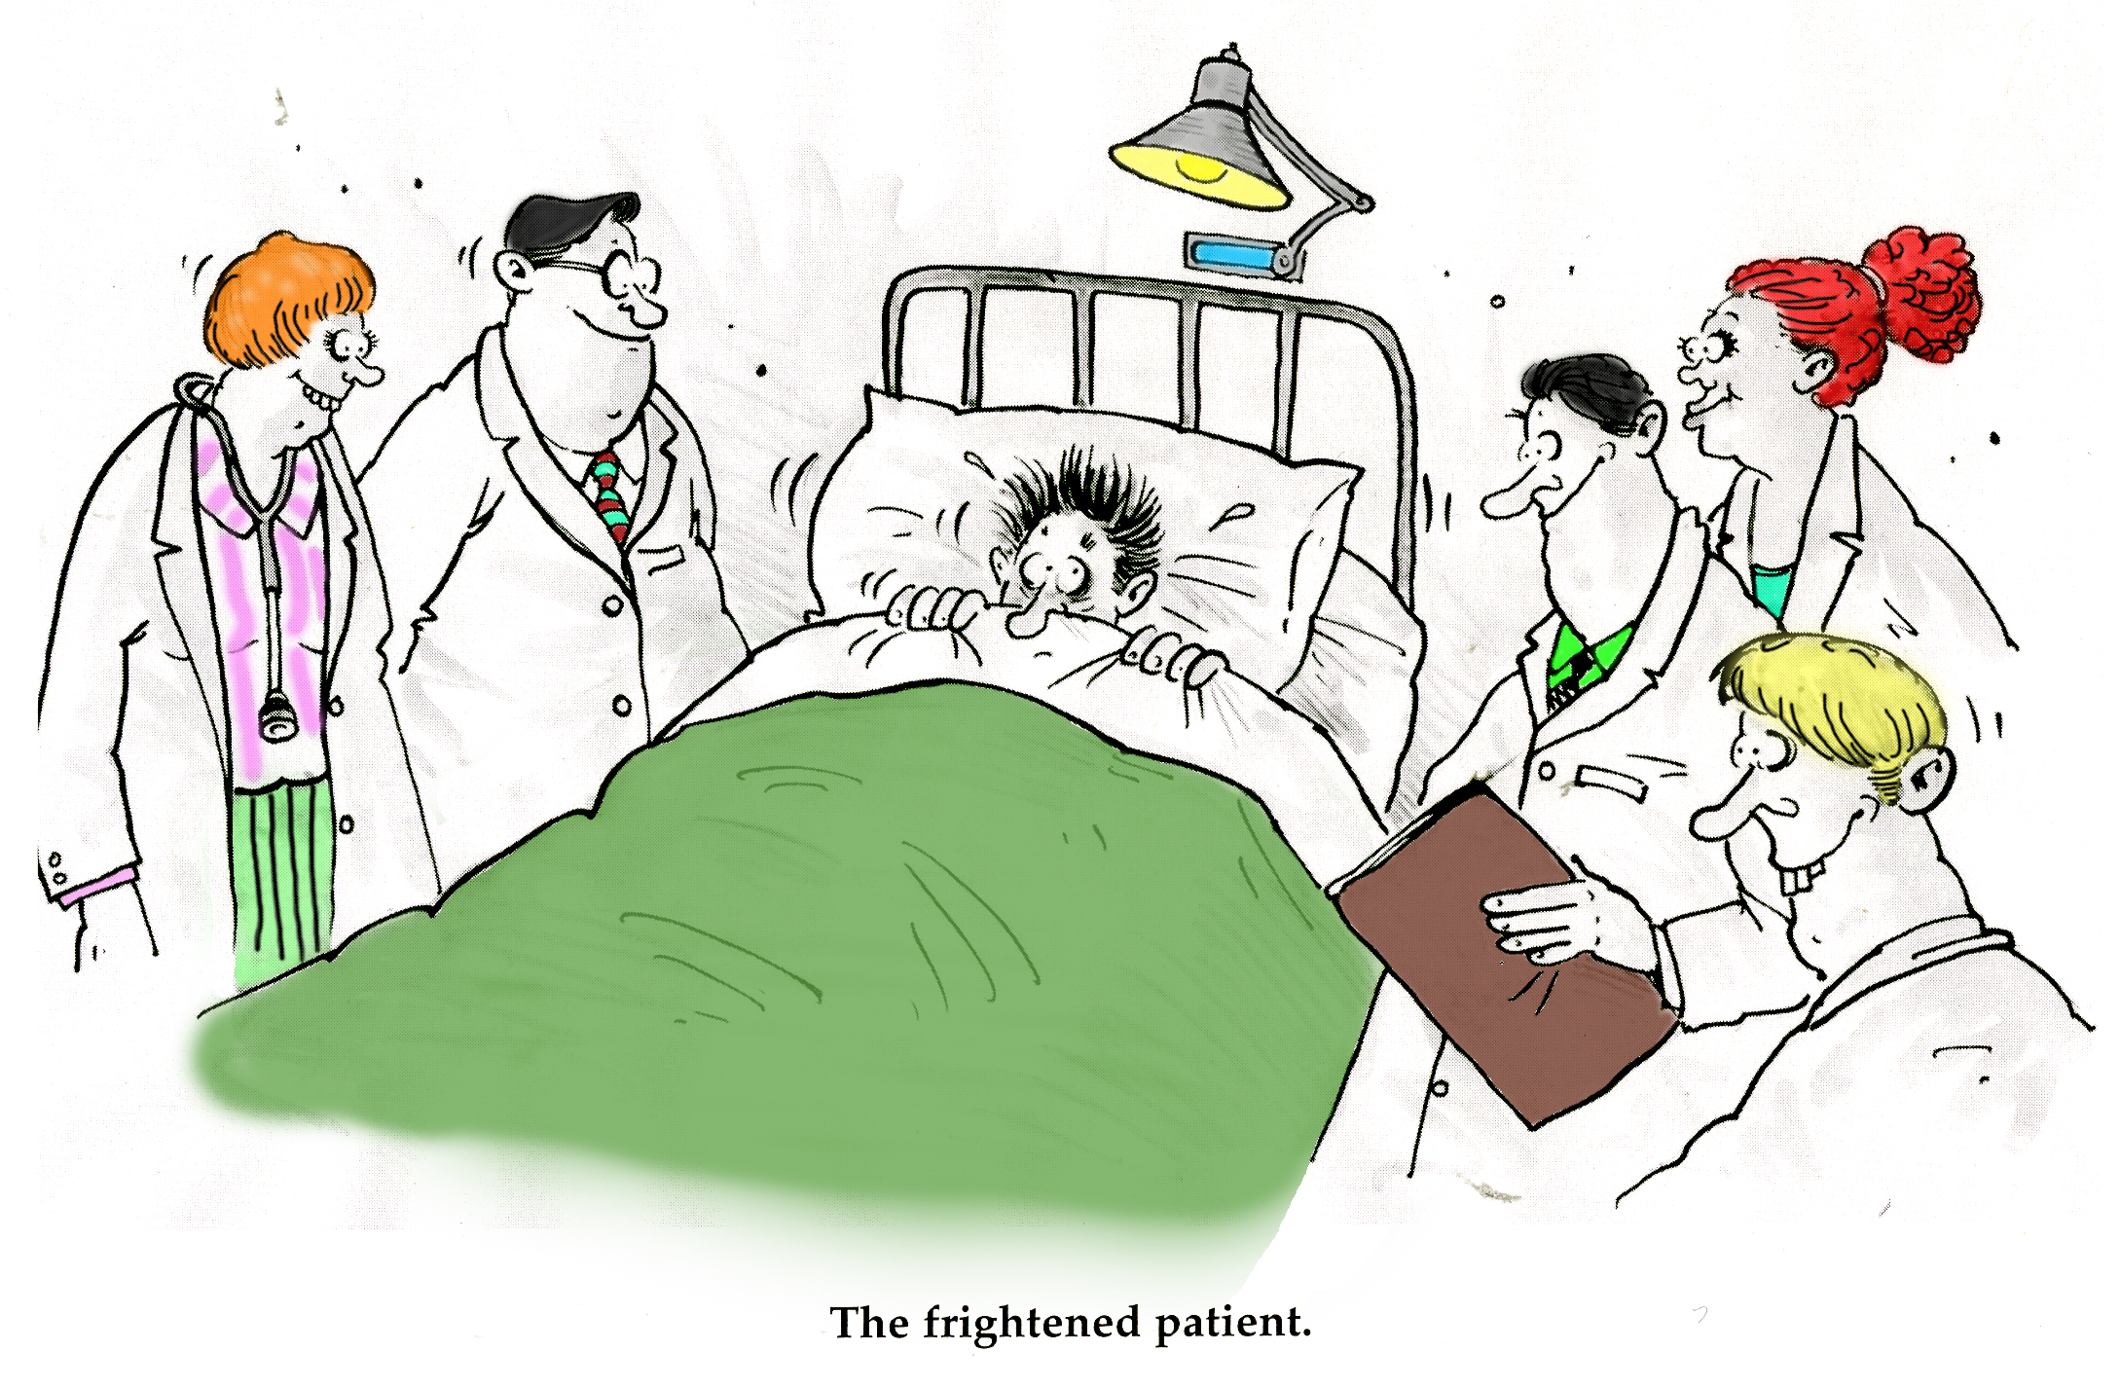

Slide 33
Communication Teaching
Glasgow 1967
“ It is most important that the patient does NOT understand......”

Slide 34
euphemisms
Chronic disease
Specific disease
Mitotic lesion
14/9

Slide 35
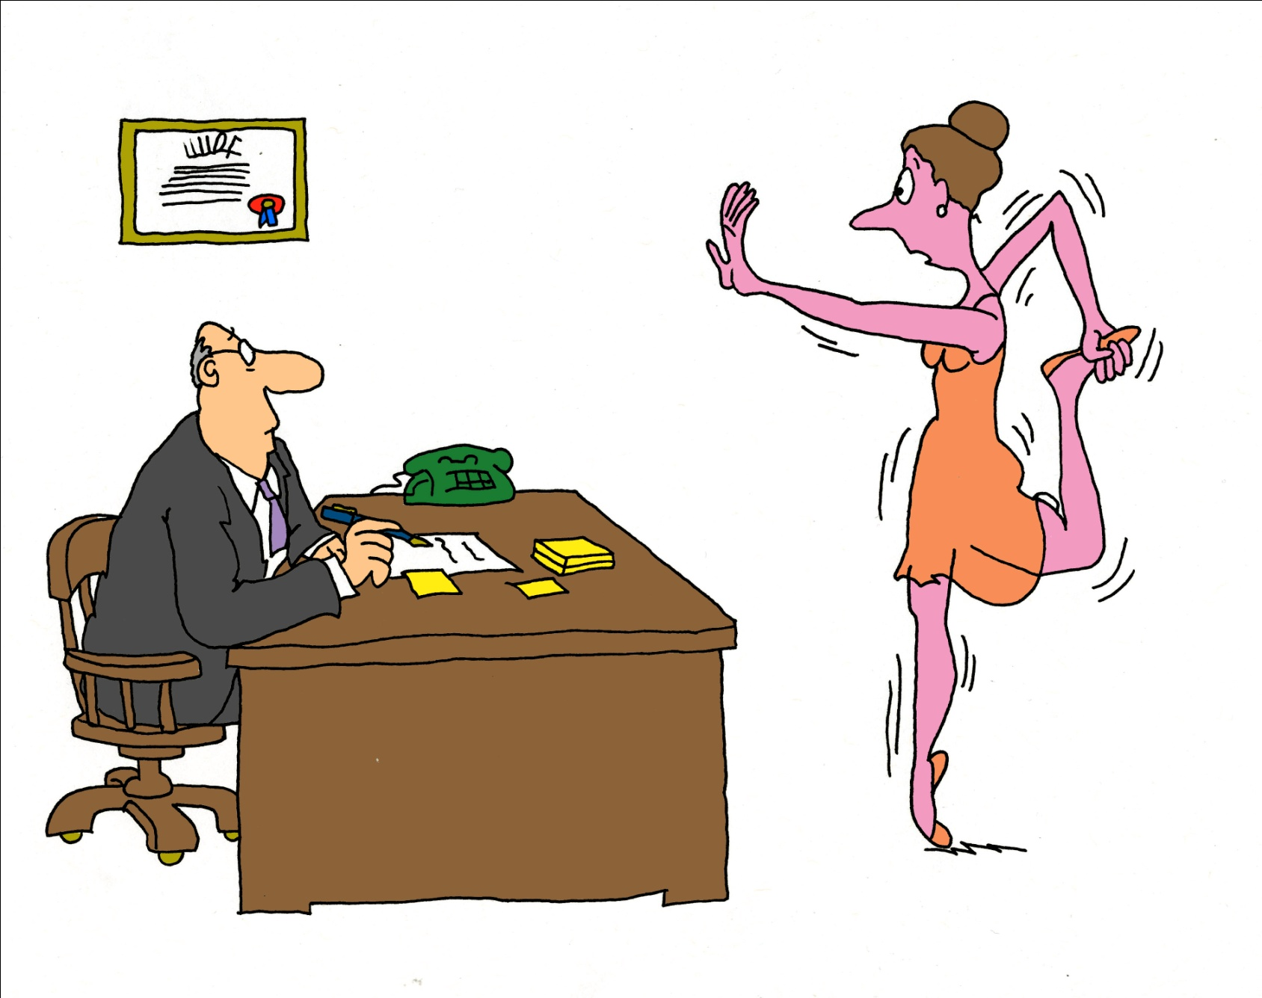
It hurts when I
Do this, doctor

Slide 36
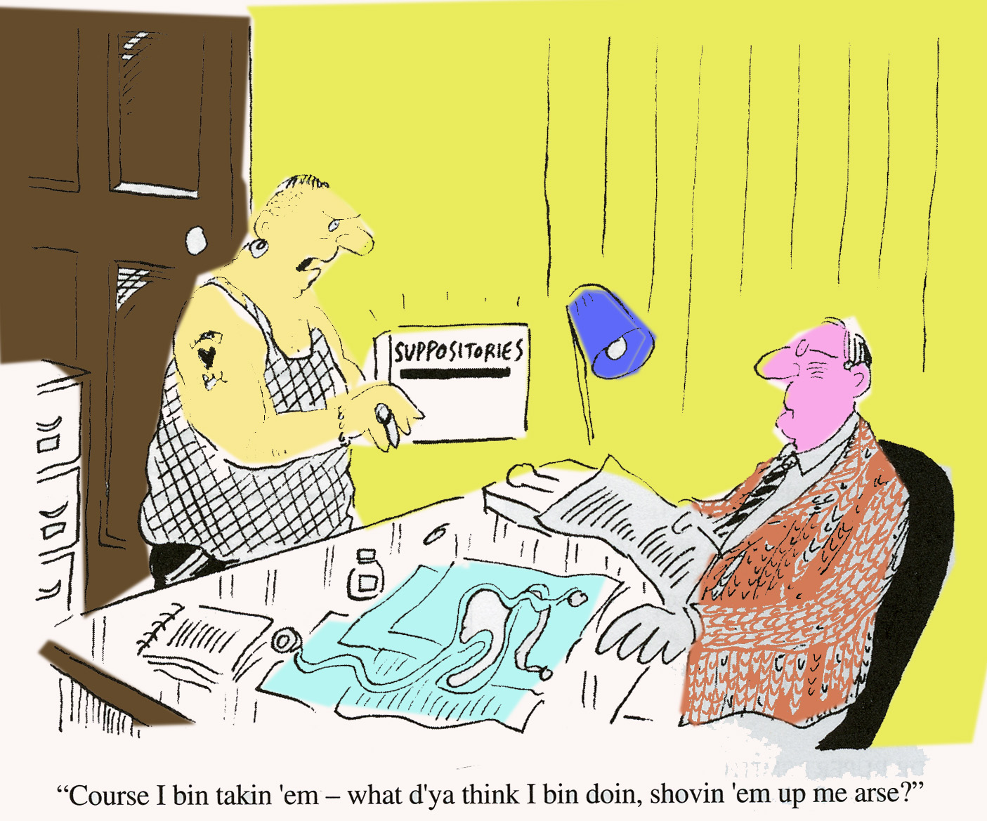
“Course I bin takin ‘em – what d’ya think I bin doin, shovin ‘em up me arse?”
Notes:
Education needed

Slide 37
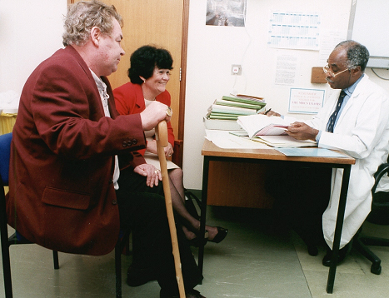
Importance of checking understanding

Slide 38
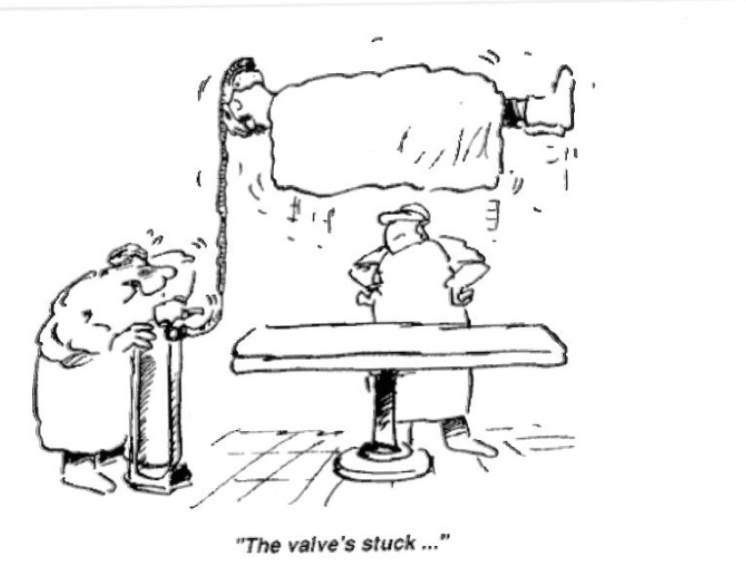

Slide 39
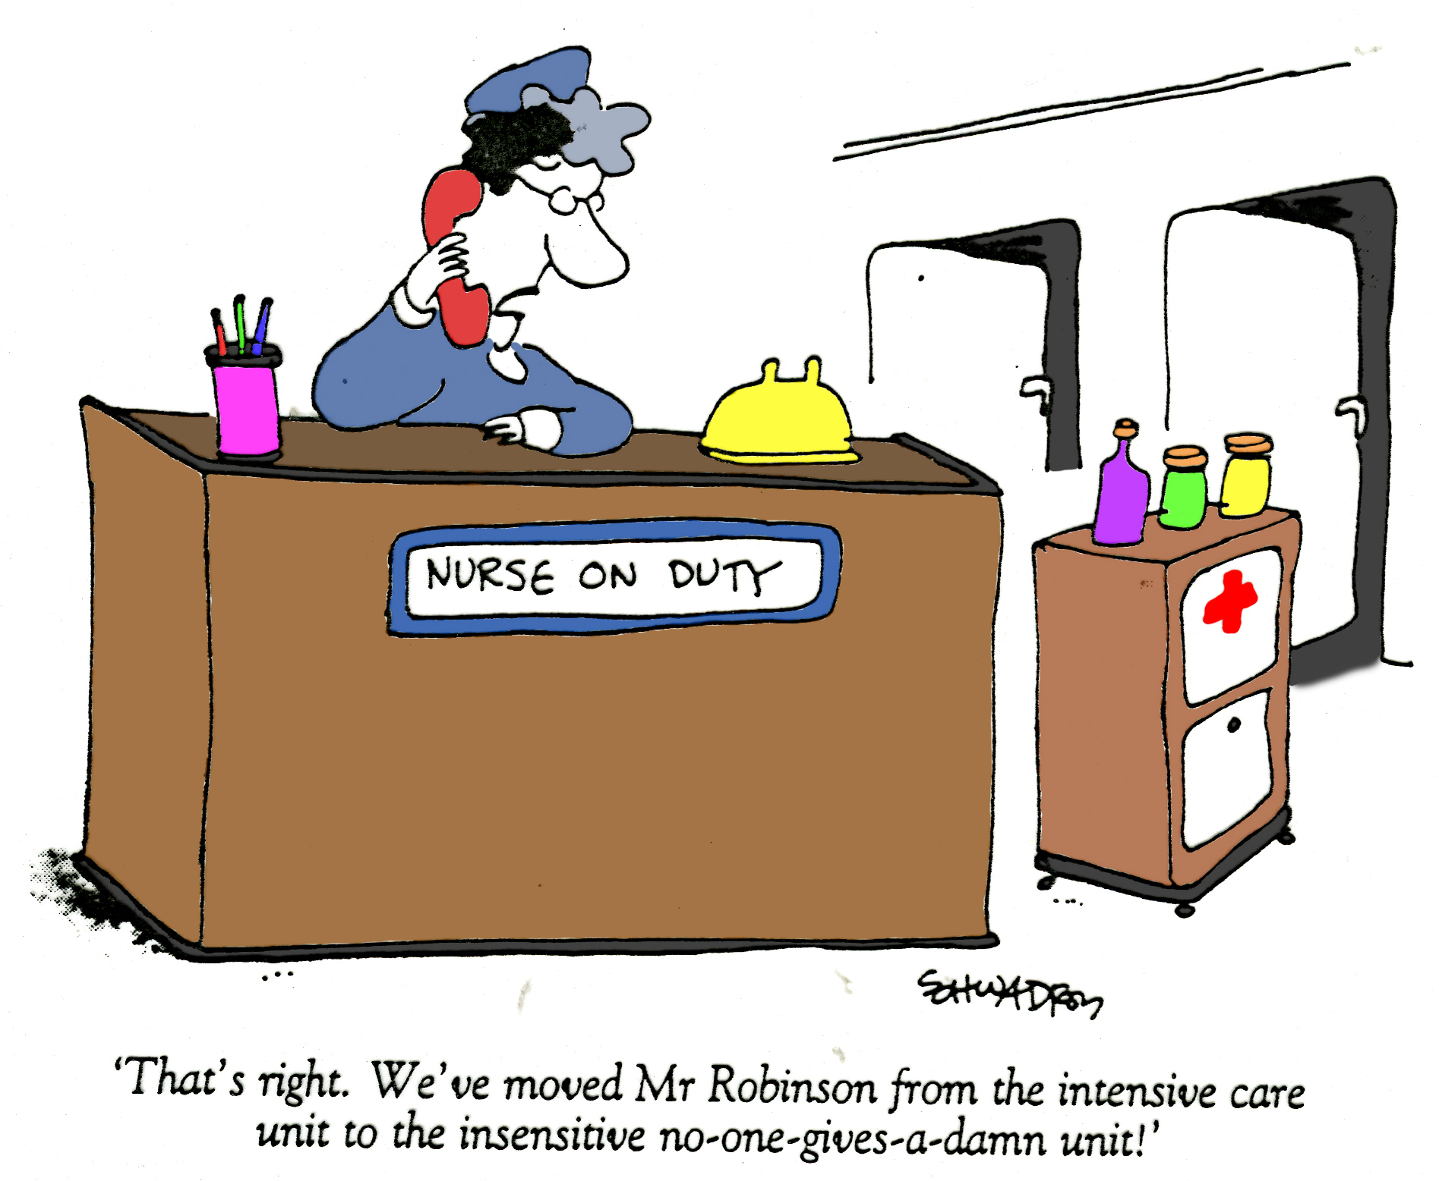

Slide 40
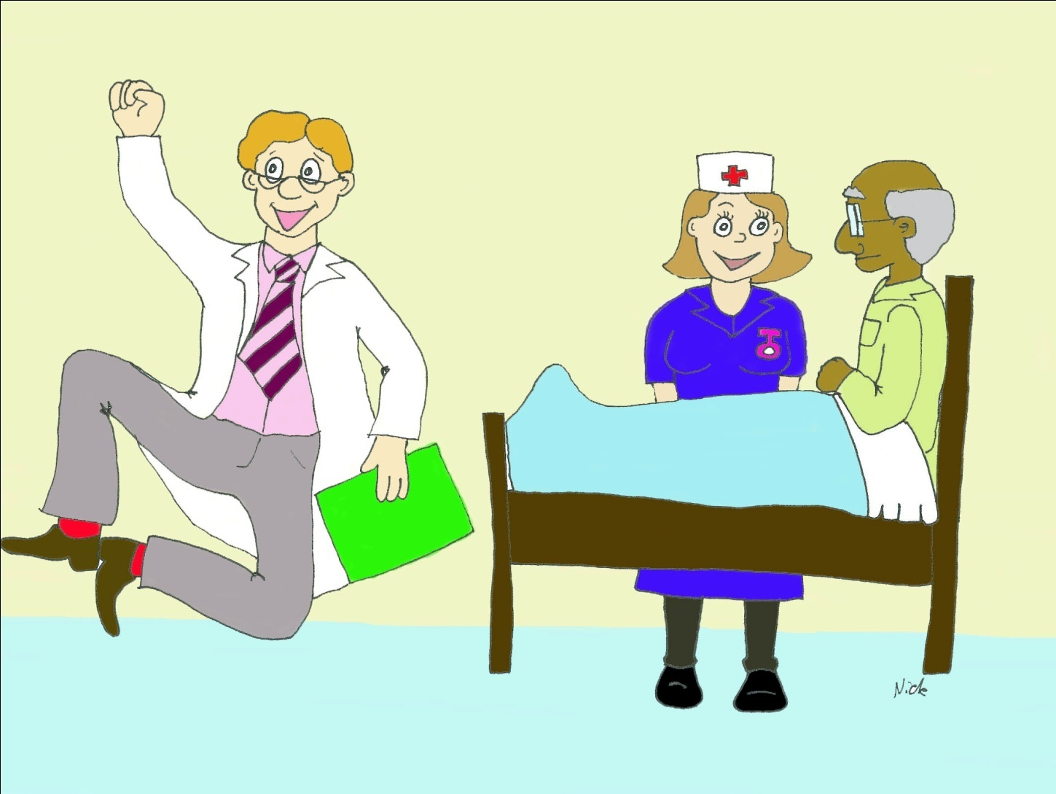

Slide 41
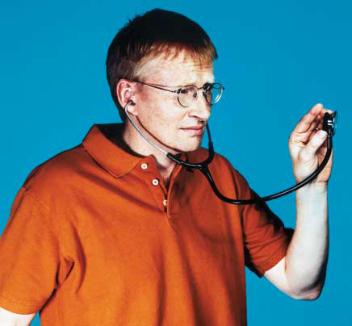
LAST LAUGH
The whole
truth?
tried to be, the more likely the consultation would end in “Bollocks to that.”
It costs £250 000 to train a doctor, and in a lifetime each doctor will dish out around £2m worth of treatments. But at best only 1 in 3 patients swallow the tablets. It’s a phenomenal waste of time and money. I changed one man’s pills to a better brand—well,cheaper—but the pills were the same size, shape, bandolier. And just when I thought I’d got away with it, he phoned up: “Those tablets you gave, they weren’t the same. The first lot sank when I threw them down the toilet, and these ones float.”
In 1871 Oliver Wendell Homes, prominent American physician, told his medical students,“Your patient has no more right to the truth that you know than he has to all the medicine in your saddlebags. He should get only just as much as is good for him.” This information control is the foundation of medical power, but in the post-Bristol era we’ve decided British patients should be told “the

Slide 42
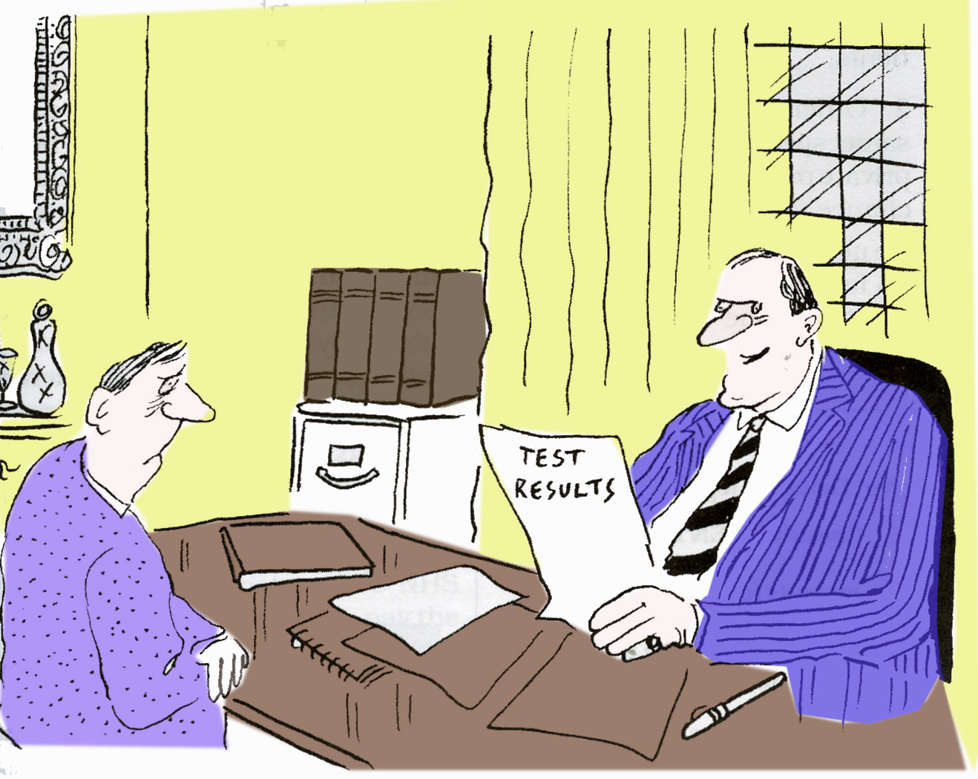
“The good news? Oh yes. You know that little blonde receptionist you
saw on your way in. Well last night I finally screwed her!”

Slide 43
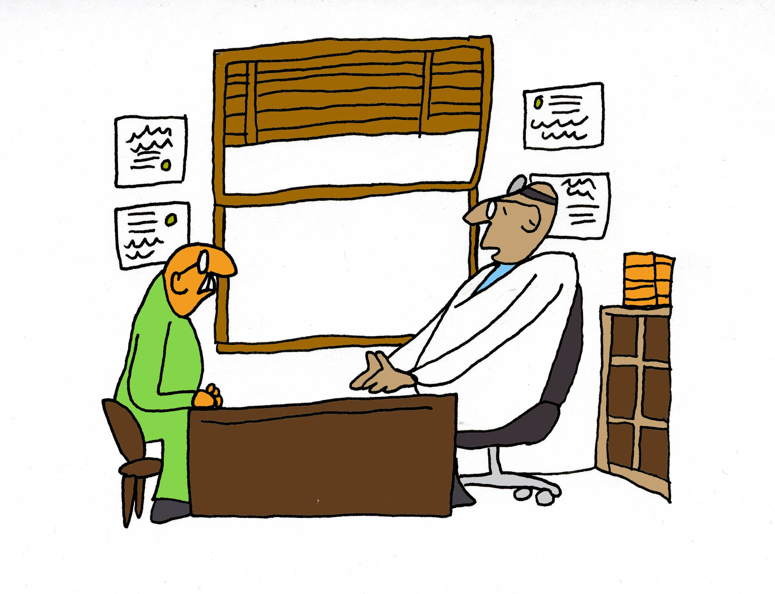
No wonder you feel sick – you make me feel sick

Slide 44
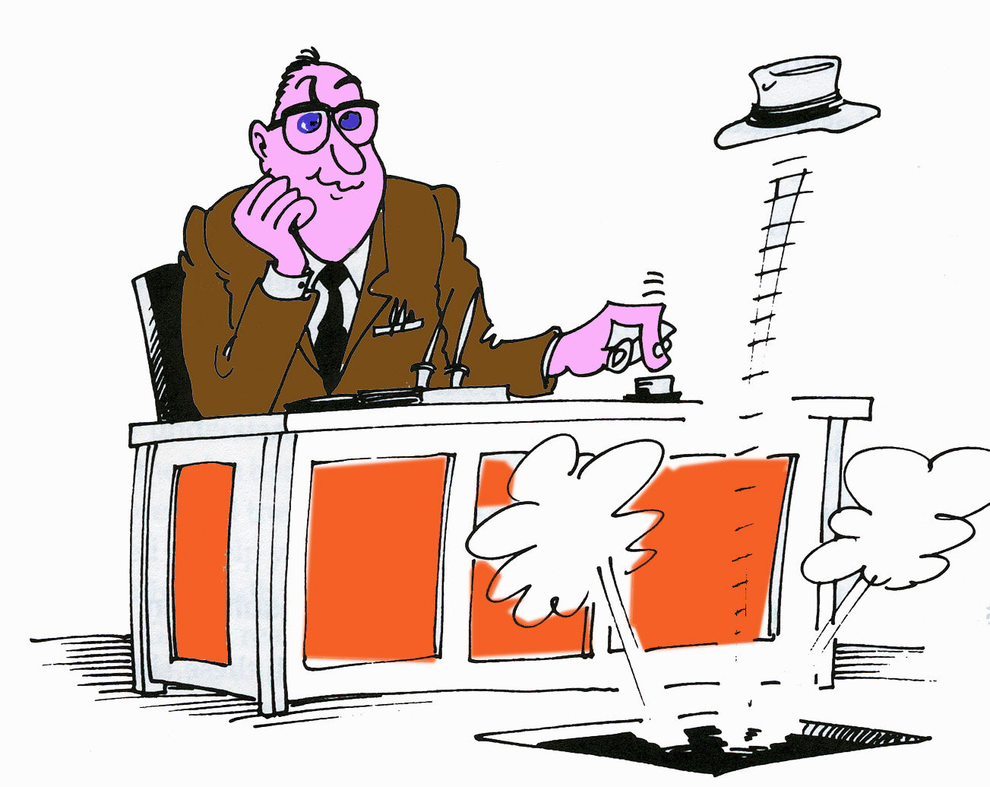
If only.................instead we resort to dark humour.

Slide 45
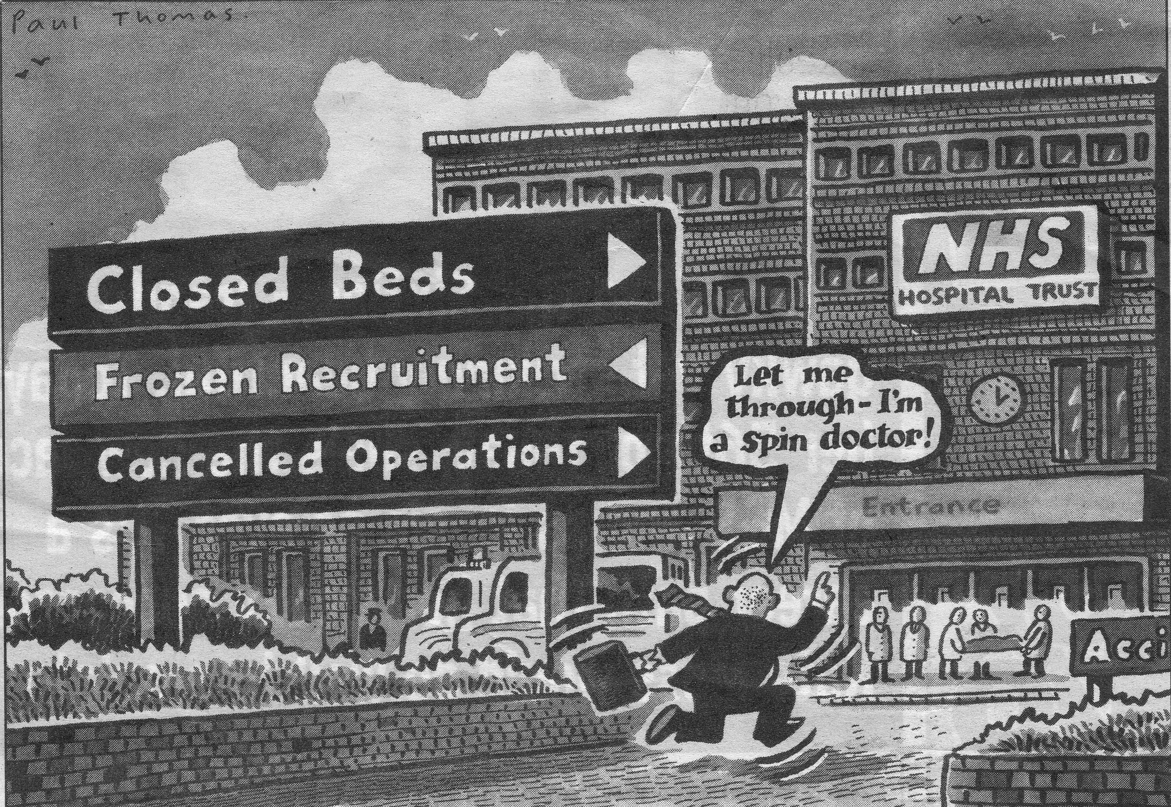

Slide 46
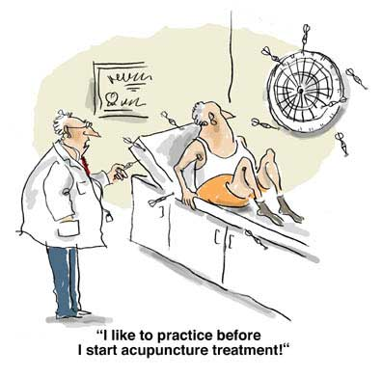

Slide 47
How are you ? fine
F
I
N
E

Slide 48
F.I.N.E.
F*cked up
Insecure
Neurotic
Emotional

Slide 49
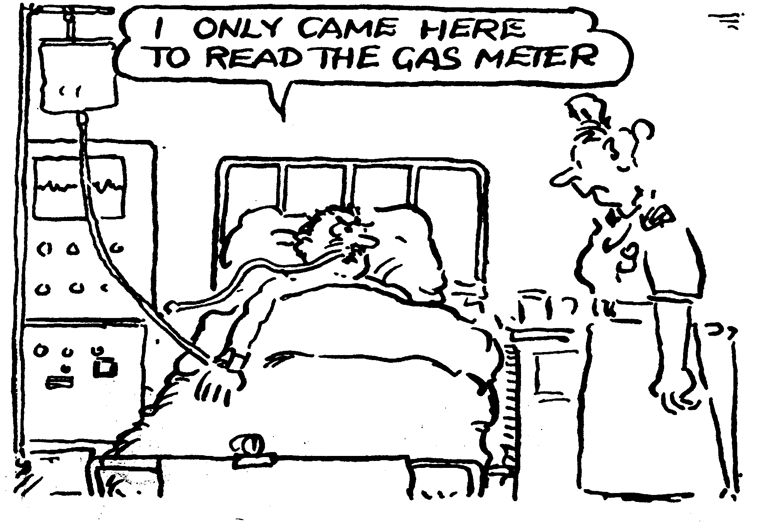
We must be prepared to learn from complaints arising from failure to comply with the strict NPSA guide on patient identification

Slide 51
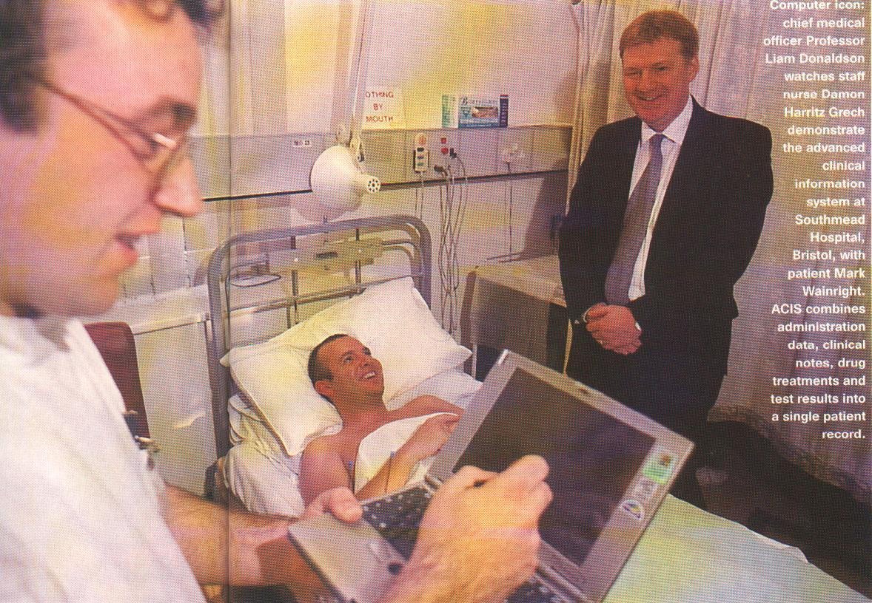

Slide 52
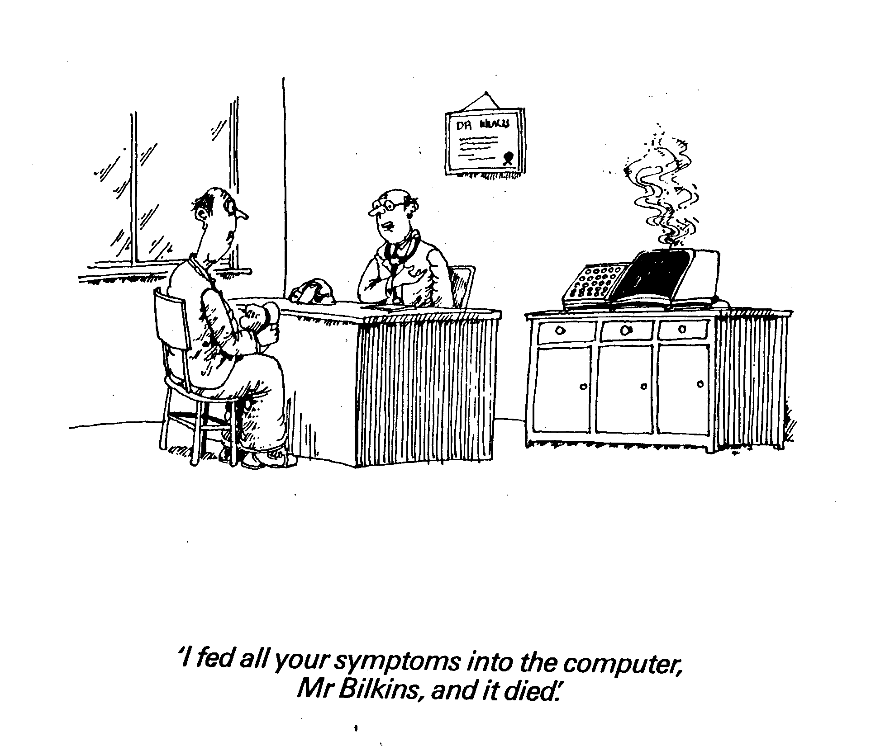

Slide 53
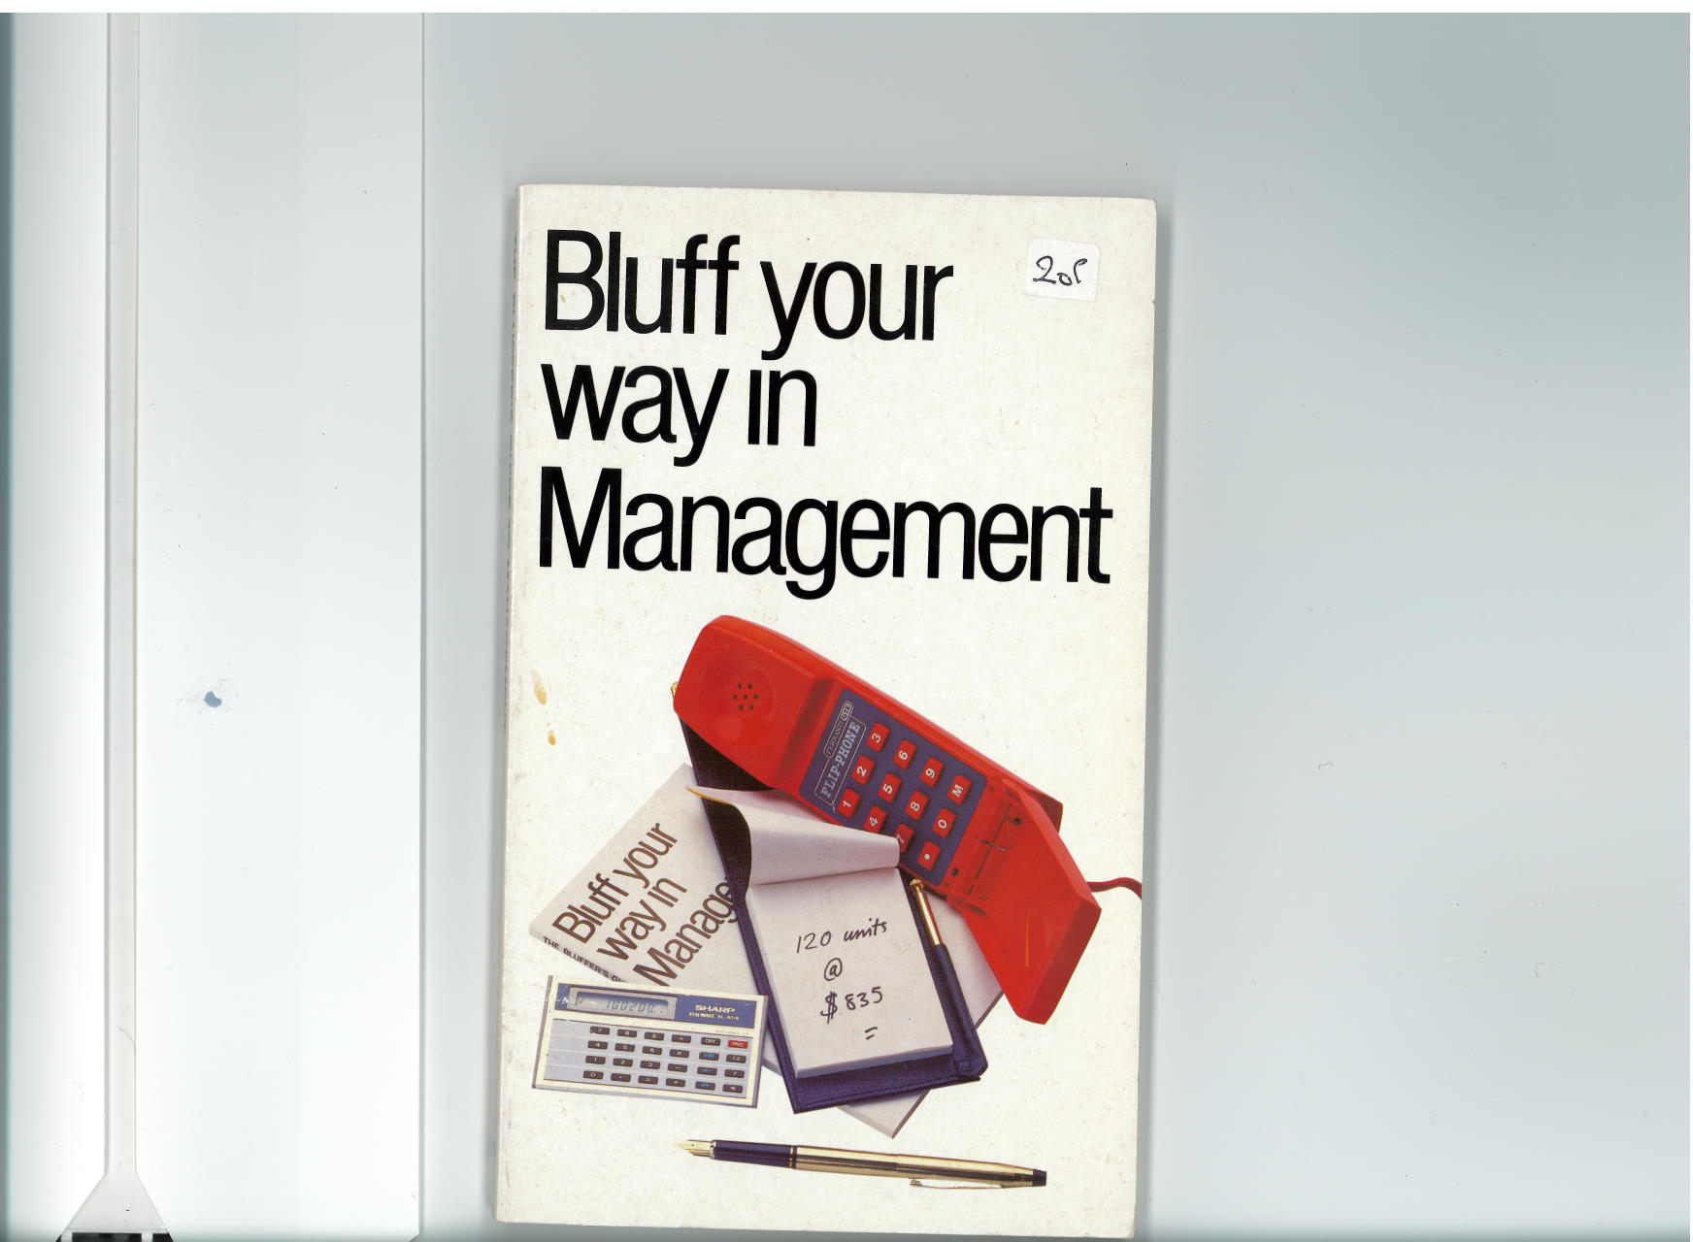

Slide 54
Doctors In Management
DiM

Slide 55
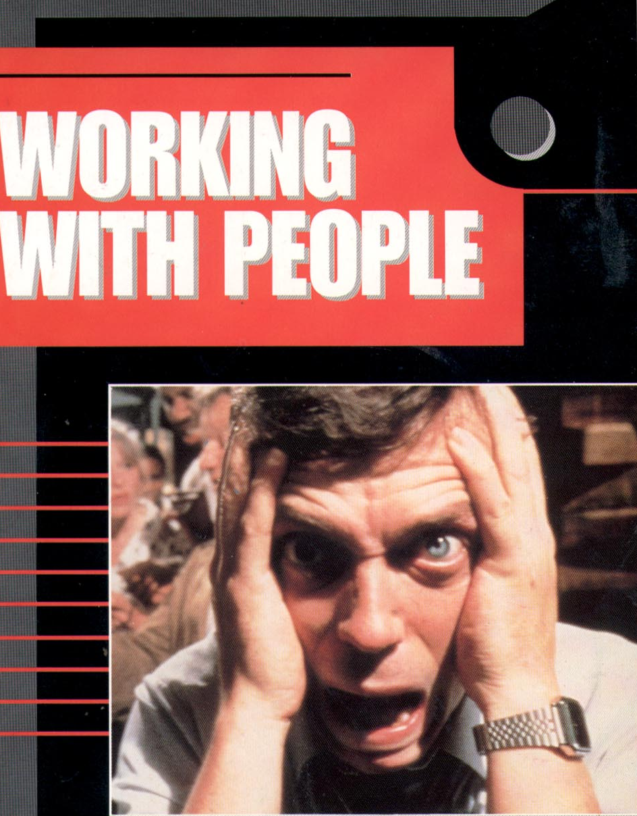

Slide 56
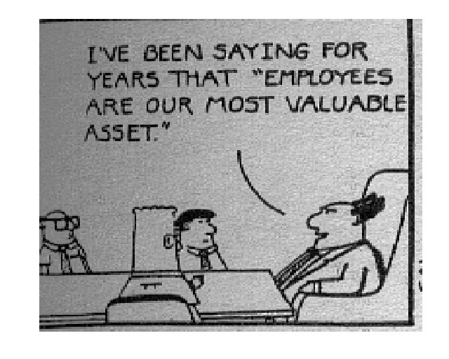

Slide 57
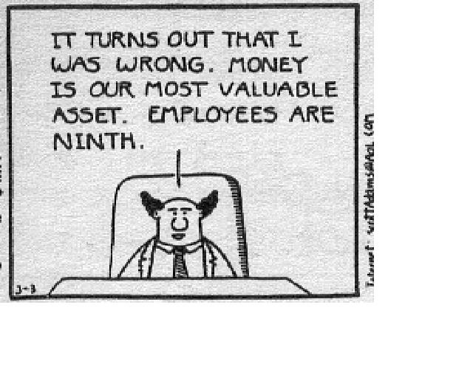

Slide 58
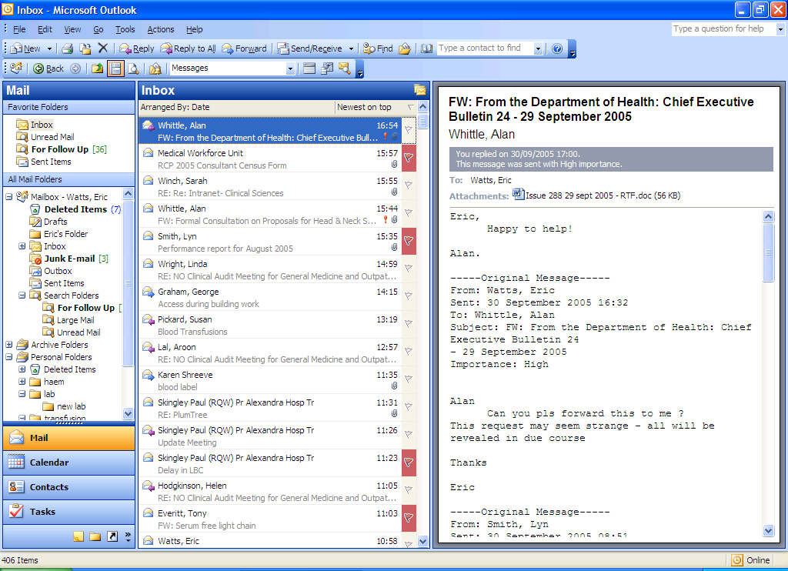

Slide 59
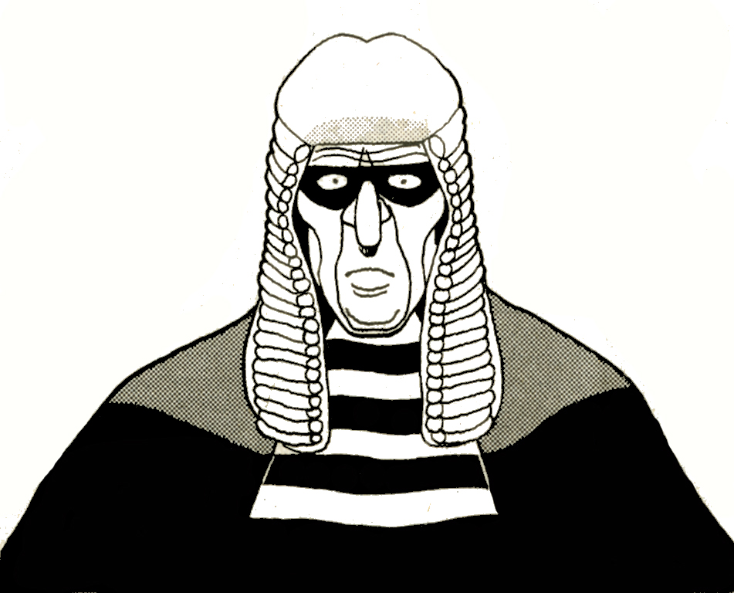

Slide 60
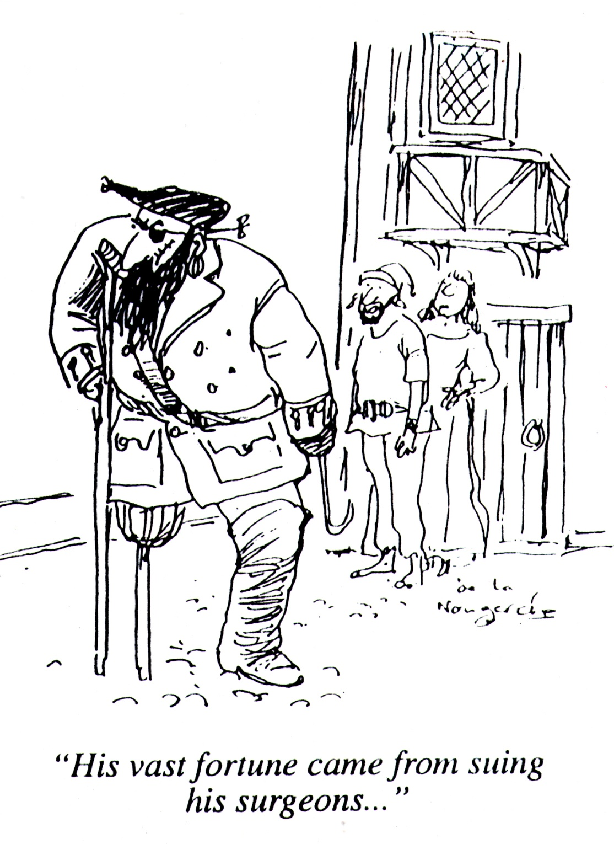

Slide 61
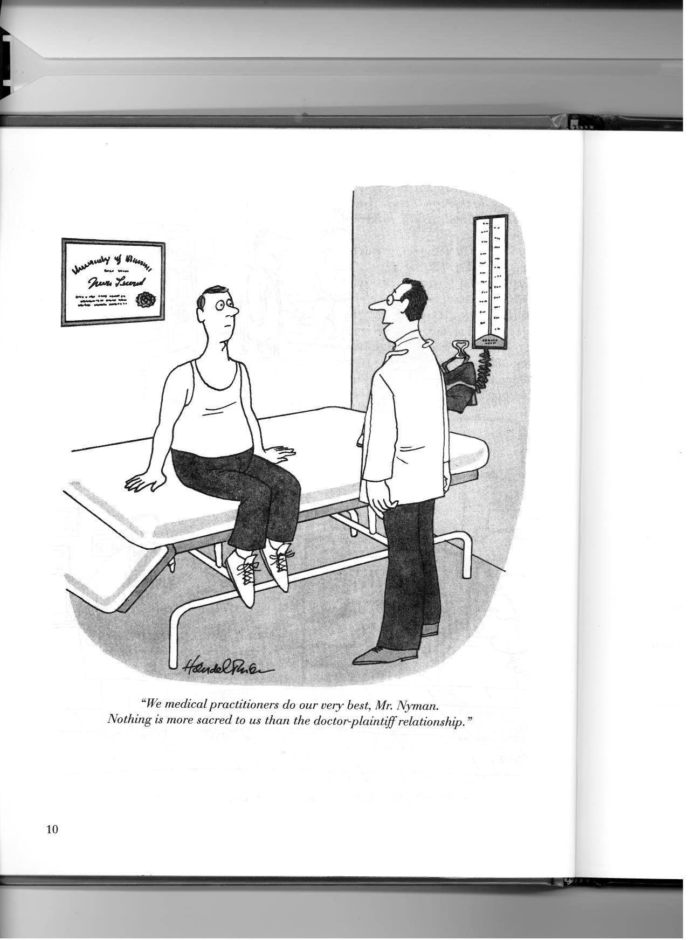

Slide 62
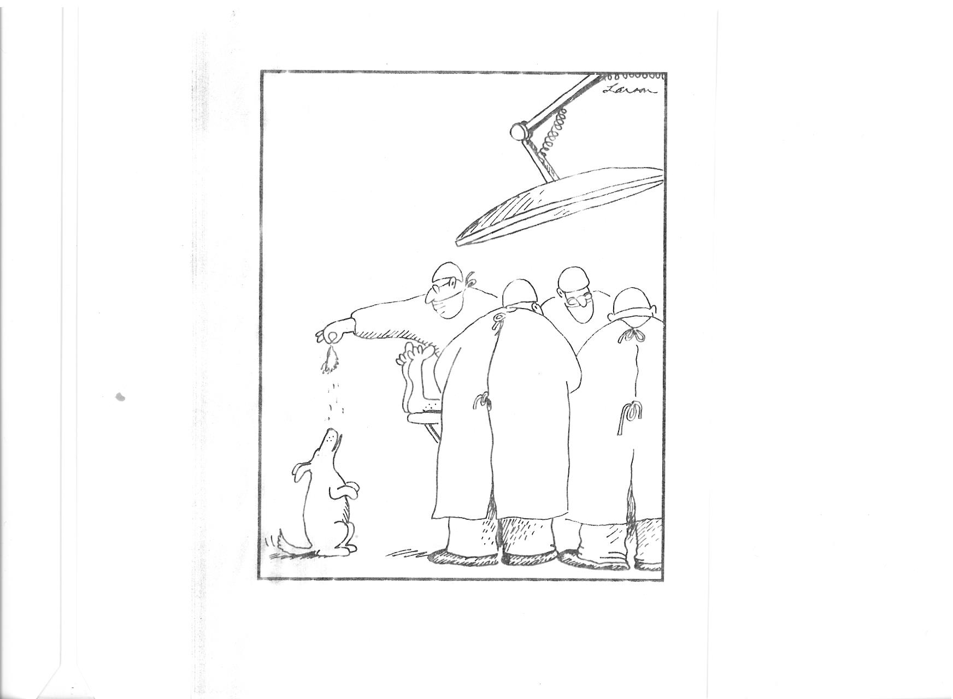

Slide 63
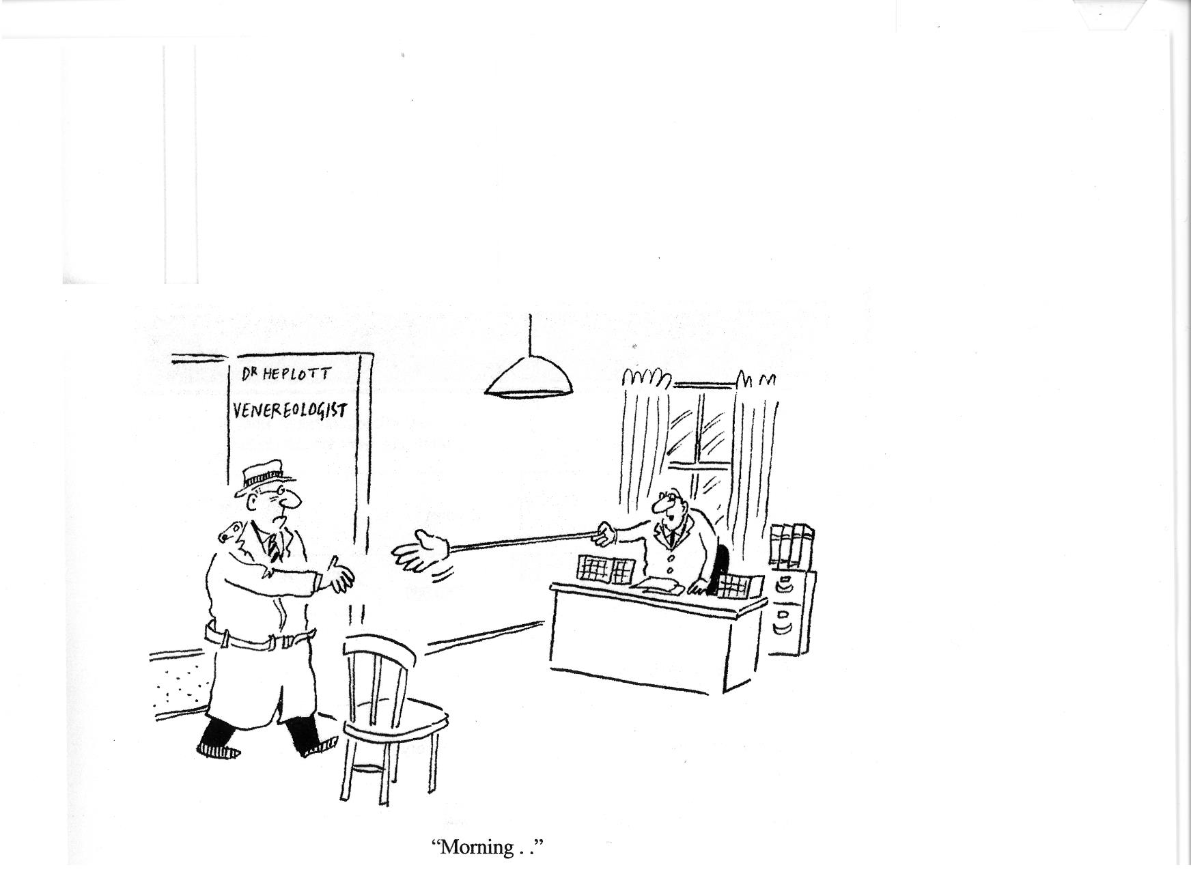

Slide 64
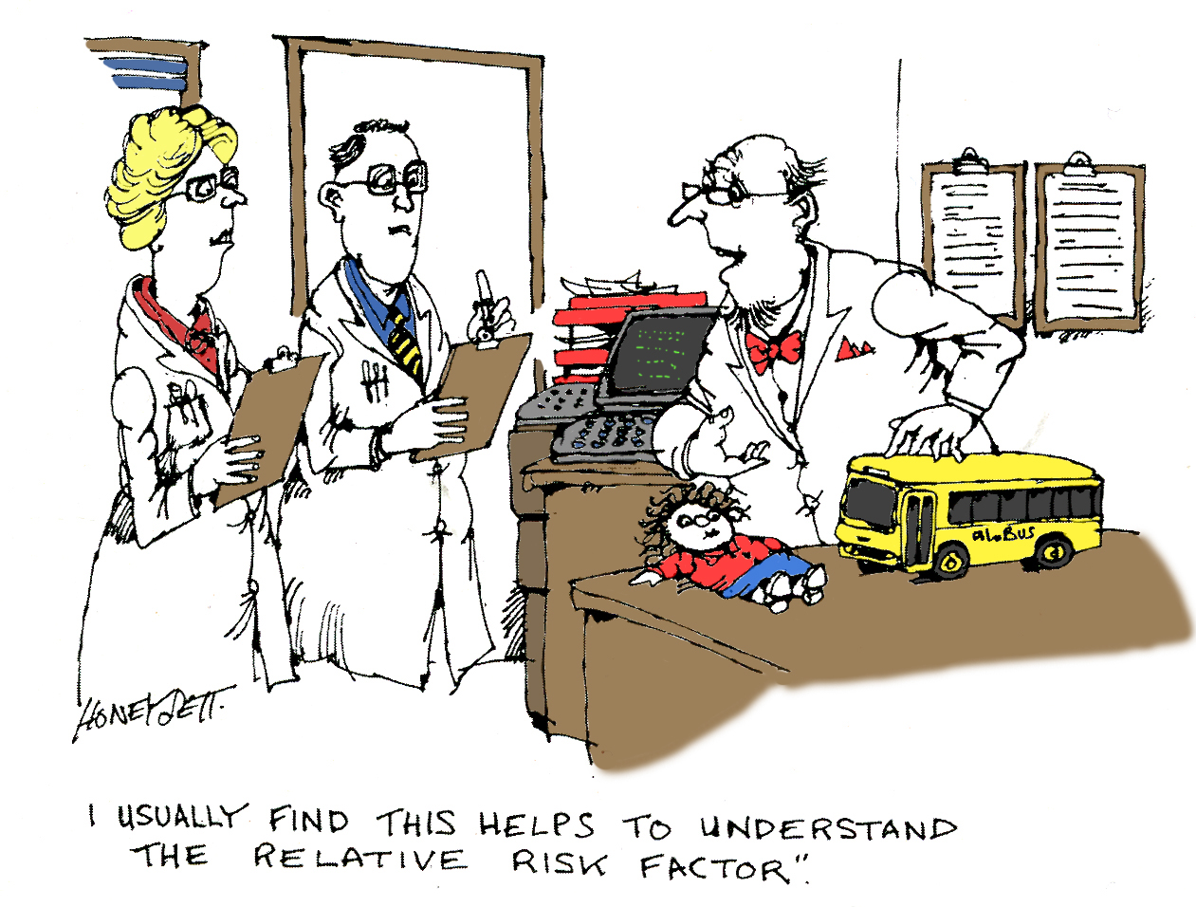

Slide 65
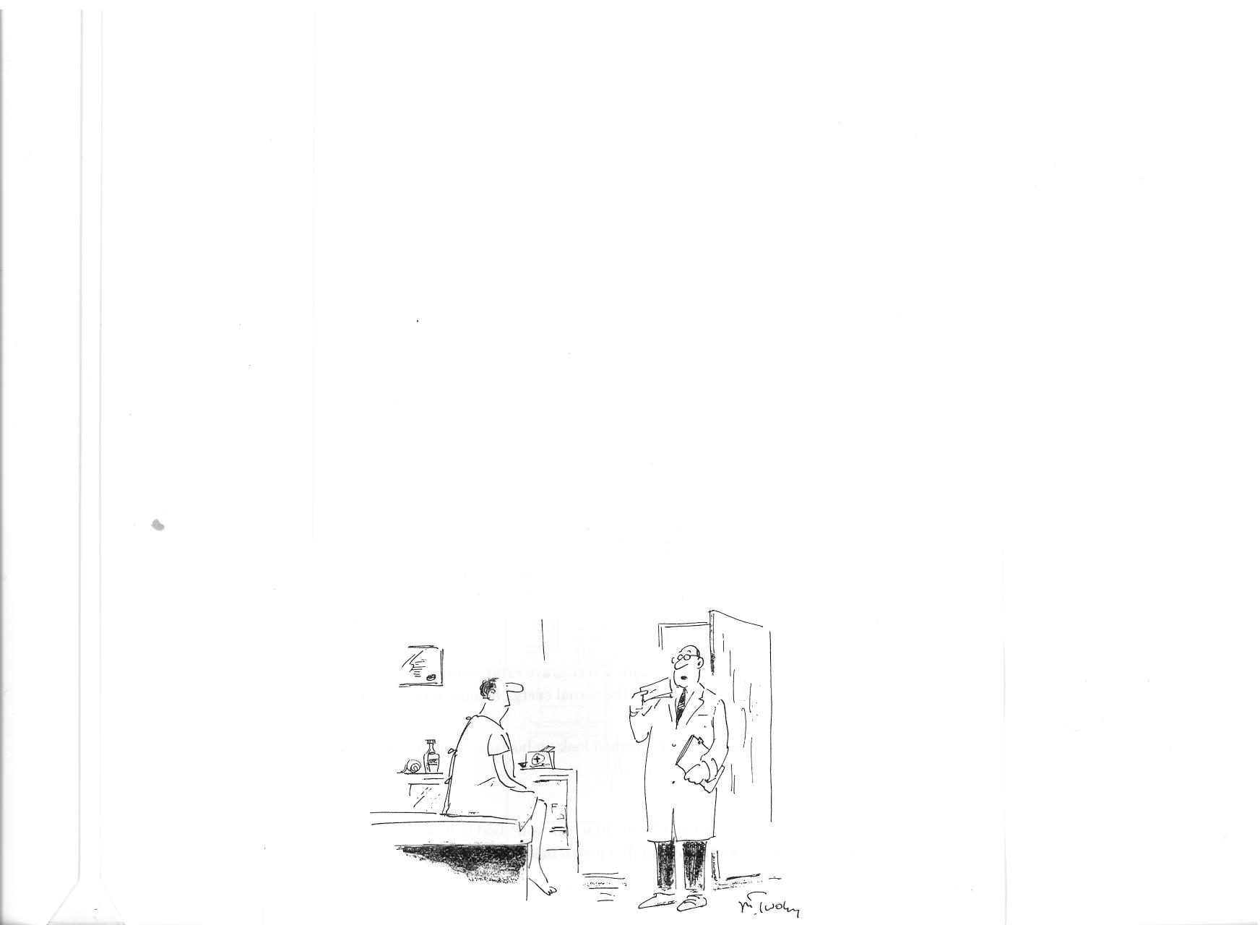

Slide 66
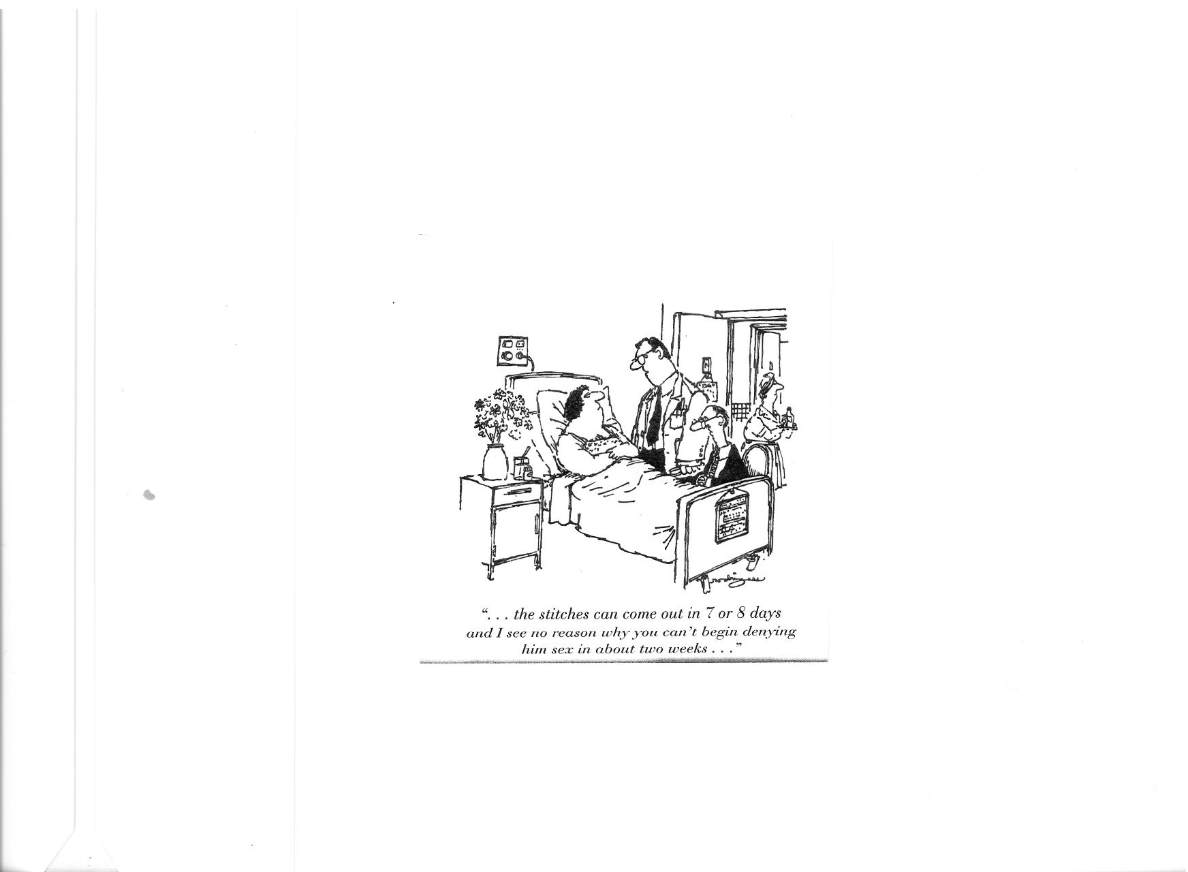

Slide 67
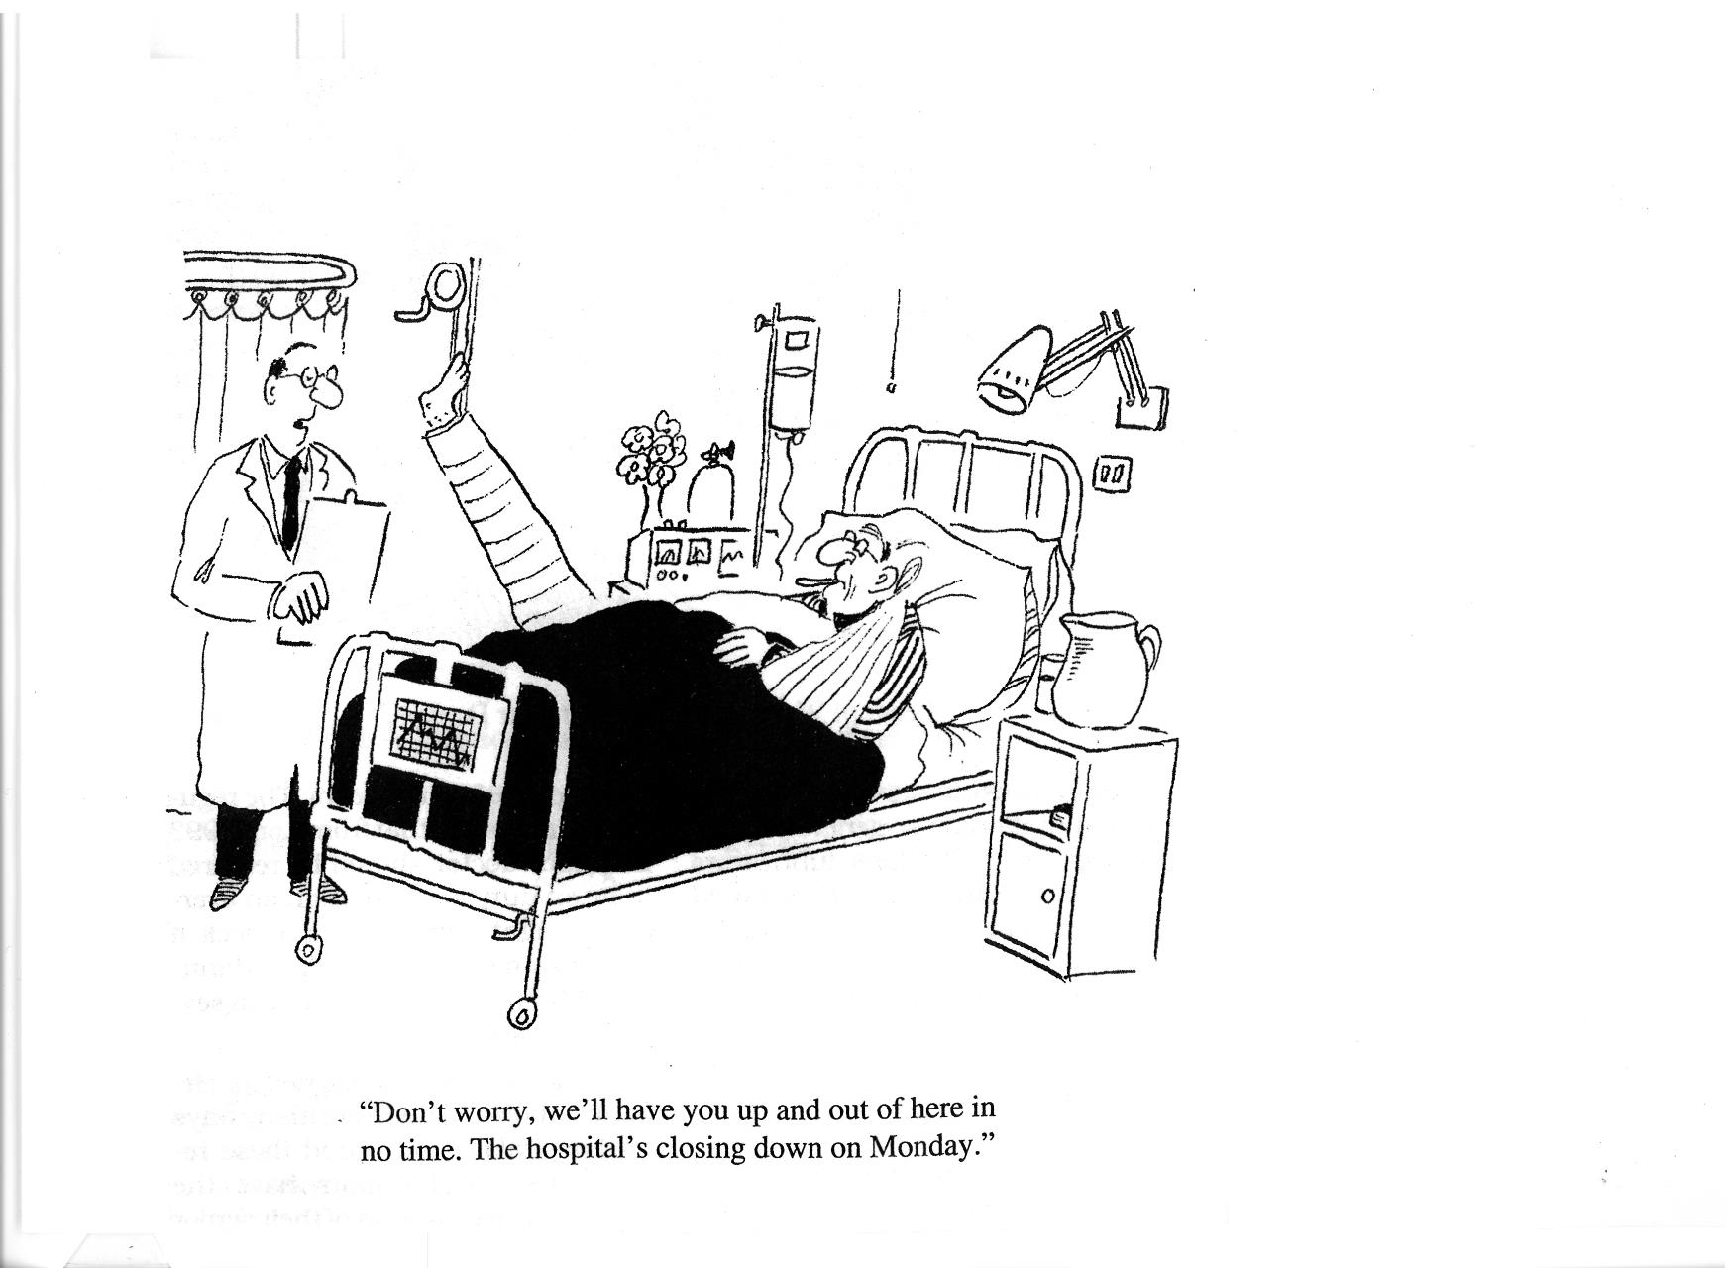

Slide 68
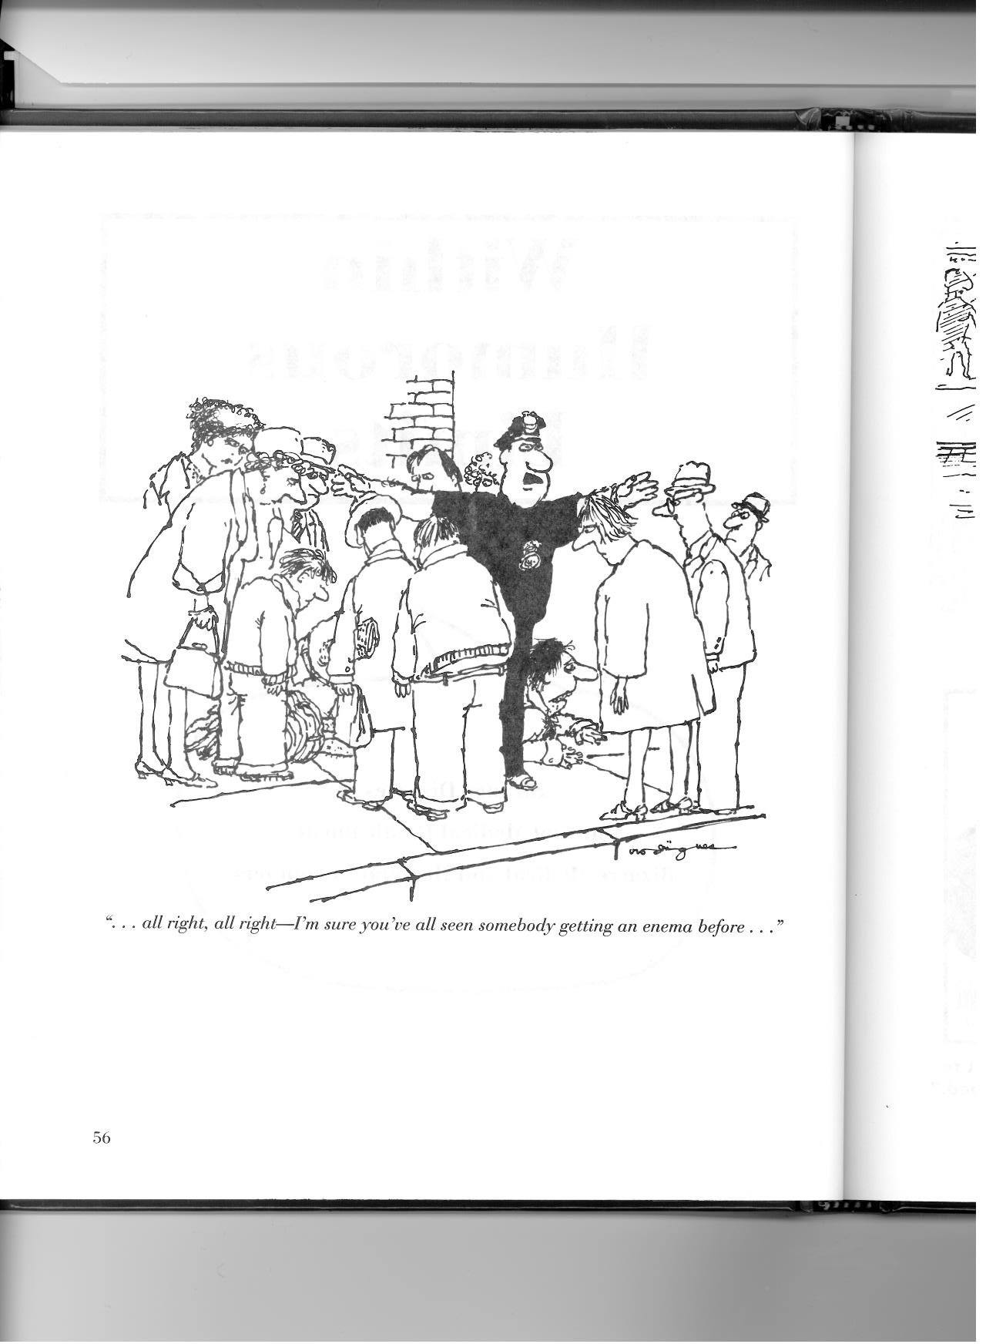

Slide 69
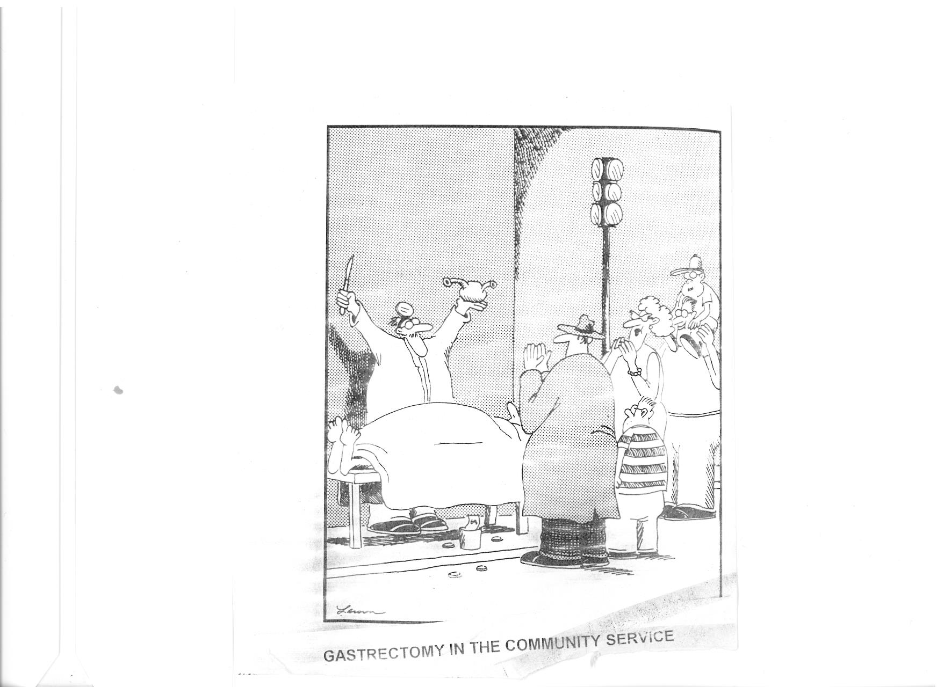

Slide 70


Slide 71


Slide 72

Queen

Slide 73
We are the champions.......
It’s been no bed of roses
No pleasure cruise
I’ve had my share of sand kicked in my face
But I’ve come through

Slide 74


Slide 75

Thanks for Listening

Slide 76


Slide 77


Slide 78


Slide 79


